Slide 1
IOT BASED AIR POLLUTION MONITORING AND FORECASTING SYSTEM
Srinithyee SK (2nd year, CSE C),
Venkataraman N (2nd year, CSE C),
Vishakan S (2nd year, CSE C)
Supervisors:
Dr. R. Priyadharsini -Associate Professor
Ms. S. Manisha - Assistant Professor
Department of Computer Science and Engineering.

Slide 2
OUTLINE OF THE PRESENTATION
Introduction
Motivation
Objective
Existing work
Proposed work
Components
Budget Distribution
Deliverables and Beneficiaries
Time Schedule
Future Scope
References

Slide 3
INTRODUCTON
The rapid development of economy, chemical, industrial park construction and production activities leads to environmental pollution accidents, especially air pollution accident.
Clustering of air pollutants cause great harm to both human and environment. It is hence important to set up a real-time air pollution monitoring system.
This system is mainly composed of perception layer, network layer and application layer.

Slide 4
MOTIVATION
Conventional air monitoring system has relatively complex equipment technology, and unstable operation
High cost and large bulk make it impossible for large-scale installation. This system can only be installed in key monitoring locations of some key enterprises, thus system data is unavailable to predict overall pollution situation.
This is replaced with inexpensive sensors,which can be laid out flexibly in the whole area to monitor omni-directionally to provide data support for prediction.

Slide 5
OBJECTIVES
A system for measuring air quality and air pollution ,displaying the required specifications and data, and to predict air quality in the future.
The outcome of the prediction and the current pollutant levels , as recorded by the sensors are displayed on an application ,which can be viewed on the mobile.

Slide 6
EXISTING WORK
The Government of India has collected datasets related to air quality from different areas. There is also an app available for viewing the National Air Quality Index(AQI) published by the CPCB.
With respect to India, a team has implemented monitoring of air pollution using sensors in real-time.
Internationally, the UN has implemented the Global Environment Monitoring System for Air (GEMS/Air)
A research work has been done on comparing air pollution data taken from sensors with chronic air-borne diseases in an area, and suggested methods to keep the pollution level in check.

Slide 7
PROPOSED WORK
We plan to collect air component parameters from various sensors.
Once the different parameters are collected, we store the same in a cloud storage facility for further access/calculations.
Once we have a sufficiently large dataset available, we plan to use the same to predict air quality for a later point in time.
The analyzed value and predicted value would be displayed to the user along with the air quality parameters to the end user via a mobile application.

Slide 8
ARCHITECTURE DIAGRAM
FIELD SENSOR
PERCEPTION
DATA
TRANSMISSION
CLOUD / LOCAL HOST

Slide 9
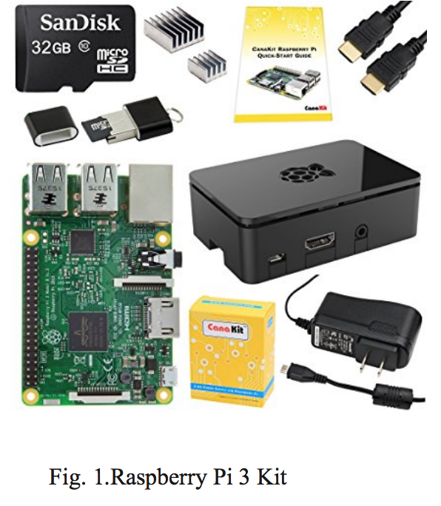
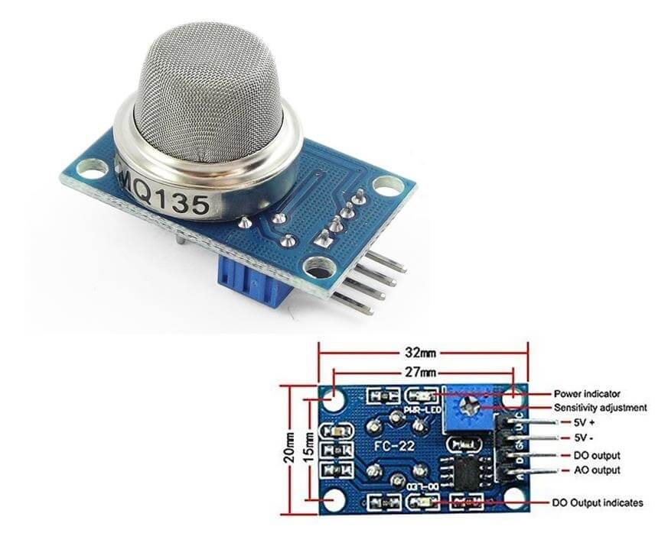
COMPONENTS
Fig. 2 .MQ 135 Air Quality Sensor

Slide 10
RASPBERRY PI
The Raspberry Pi is a single-board computer to which various additional features can be added via external add-ons.
The advantage of computing on a Raspberry Pi is that it can be easily programmed to perform the desired user functions.
In our project, the Raspberry Pi is used to receive measurement details from the sensors implemented using the Arduino board and perform predictive analysis.
It is also used to transmit the sensor data onto the cloud for easy access and for further analysis.

Slide 11
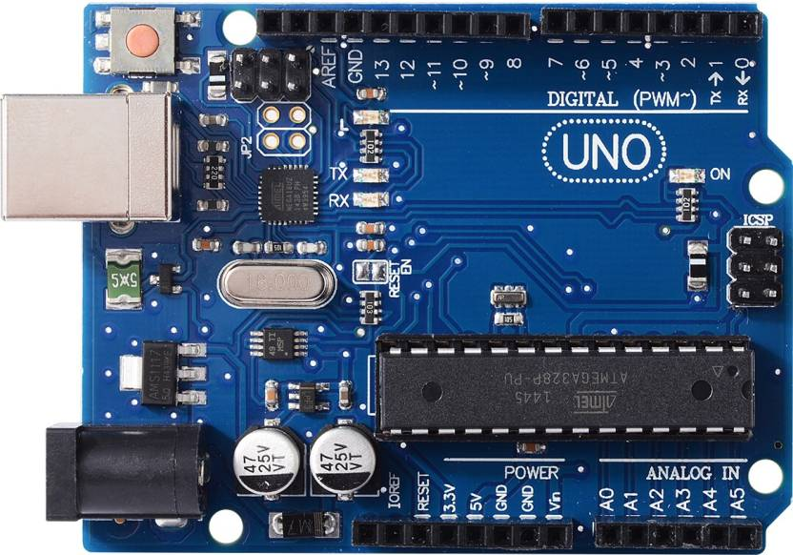
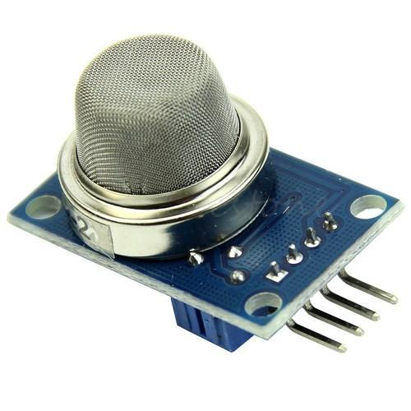
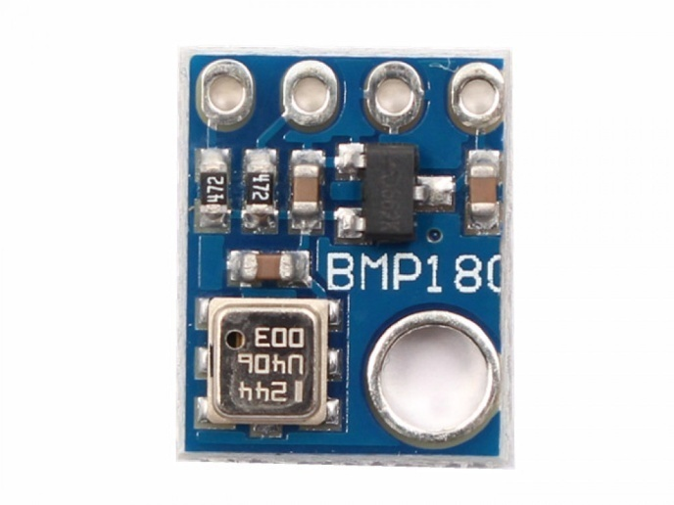
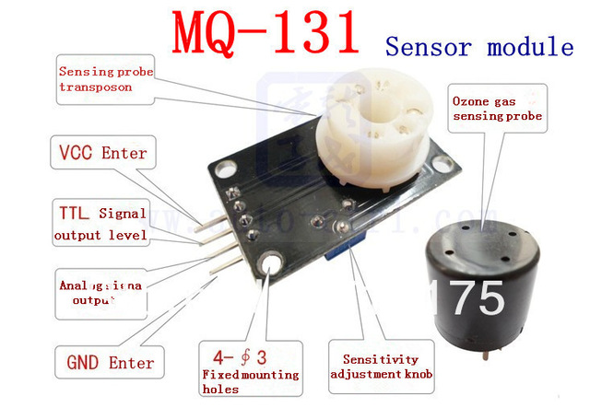
Fig. 4. MQ2 Smoke Sensor
Fig. 5. Arduino Uno r3
Fig. 6. BMP180
Fig. 7. MQ 131 Ozone Sensor

Slide 12
THE ARDUINO
It is a microcontroller platform basically used to deal with hardware and sensors.
Here, we use it to transmit the data obtained from the sensor array to the Raspberry Pi, to supply power to the sensor circuitry, and to control the working period of the sensor

Slide 13
Budget Distribution
Total Budget Estimation: Rs. 21,000

Slide 14
Component | Quantity | Price Per Unit | Net Price
MQ135(Air Quality) sensor | 1 | 200 | 200
MQ2(Smoke) sensor | 1 | 300 | 300
MQ7(Carbon Monoxide) sensor | 1 | 300 | 300
MG811(Carbon Dioxide)sensor | 1 | 4000 | 4000
Raspberry Pi 3 | 1 | 3000 | 3000
MQ138(Benzene & Toluene) | 1 | 5000 | 5000
WIFI adapter | 1 | 250 | 250
Arduino Uno r3 | 1 | 400 | 400
USB power cord | 1 | 250 | 250
Temperature and pressure sensor | 1 | 300 | 300
DSM501A(Air dust)sensor | 1 | 2000 | 2000
BMP 180 | 1 | 200 | 200
BreadBoard | 1 | 100 | 100
MQ131(Ozone) | 1 | 3000 | 3000
Miscellaneous | _ | _ | 1700
TOTAL |  |  | 21,000/-

Slide 15
DELIVERABLES AND OUTCOMES
Getting real-time data on air quality parameters of an area periodically.
Predict the air quality for a future time based on the available dataset.
Gives the general public awareness about the air quality of their locality.
Can be used to alert factory management in case of high pollution/expectation of high levels of pollution in the factory premises.
Helps meteorologists and environmentalists by giving them a realistic dataset, which can be used by them to understand the severity of air pollution in an area, and take appropriate measures.

Slide 16
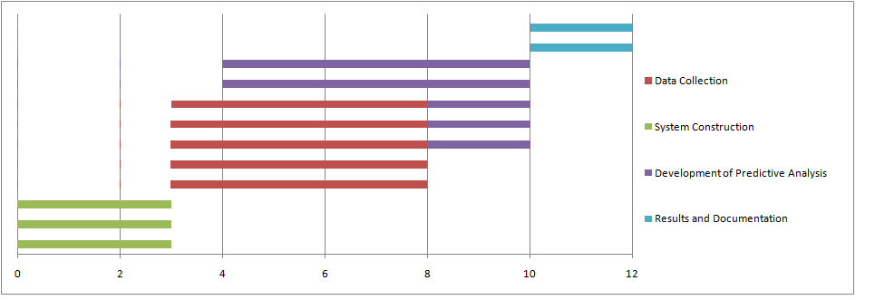
TIME SCHEDULE

Slide 17
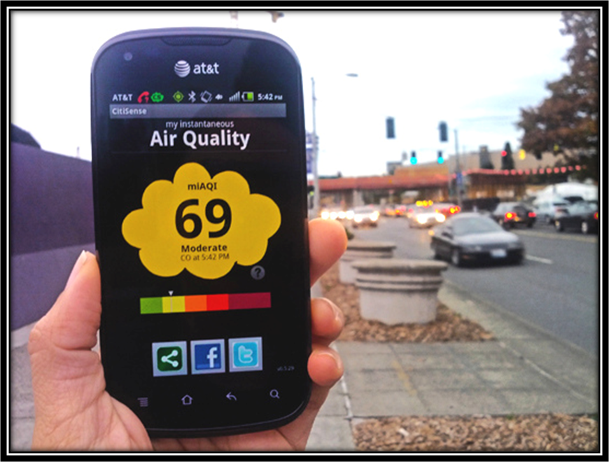
FUTURE SCOPE/IMPROVISATION
1. Targeting air-pollution hotspots, like an industry/factory and monitoring & predicting air quality in that area, for the benefit of factory workers and nearby residents. Will be very useful in highly industrialized areas, so that pollution can be kept in check.

Slide 18
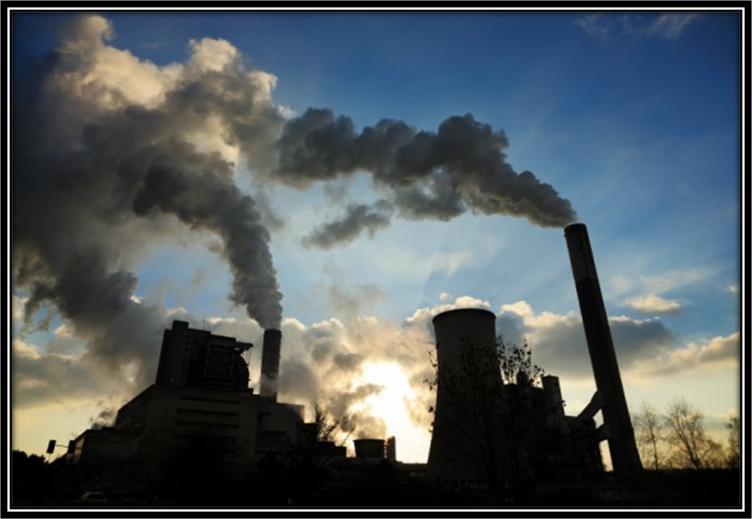
2. Government supervised monitoring of bio-diverse places like forests, rivers, lakes that come near factories/power plants/mines for air pollution, so that immediate action can be taken by authorities in case of abnormalities in air quality levels. Factories can also be kept in check in real-time on whether they satisfy government policies relating to discharge of smoke.

Slide 19
REFERENCES
[1] Chen Xiaojun, Liu Xianpeng and Xu Peng, “IOT- Based Air Pollution Monitoring and Forecasting System”.
[2] Somansh Kumar and Ashish Ahuja, “Air Quality Monitoring System Based on IoT using Raspberry Pi”.
[3] Gagan Parmar, Sagar Lakhani and Manju K. Chattopadhyay, “An IoT Based Low Cost Air Pollution Monitoring System”.
[4] Akshata Tapashetti and Divya Vegiraju, “IoT-Enabled Air Quality Monitoring Device-A Low
CostSmart Health Solution”.

Slide 20
[5] LuiSha ,Sathish Gopalakrishnan, Xue Liu,etal. Cyber-physical systems:a new frontier. Proceedings of 2008 IEEE Internationa lConference on Sensor Networks, Ubiquitous, and Trustworthy Computing.
[6] Gouldson A, Morton A, Pollard S J T. Better environmental regulation–contributions from risk -
based decision-making.
[7] Upton, Eben, and Gareth Halfacree. Raspberry Pi user guide. John Wiley & Sons, 2014.

Slide 21
THANK YOU

